Slide 1
Chapter 3
Multiple Regression

Slide 2
Outline
Multiple Regression Equation
The Three-Variable Model: Notation and Assumptions
OLS Estimation for the three-variable model
Properties of OLS estimators
Goodness of fit –R2 and adjusted R2
More on Functional Form
Hypothesis Testing in Multiple Regression

Slide 3
1. Multiple regression equation
Y = One dependent variable (criterion)
X = Two or more independent variables (predictor variables).
u_{i} the stochastic disturbance term
is the intercept
measures the change in Y with respect to Xk, holding other factors fixed.

Slide 4
Motivation for multiple regression
Incorporate more explanatory factors into the model
Explicitly hold fixed other factors that otherwise would be in u
Allow for more flexible functional forms
Example: Wage equation
Now measures effect of education explicitly holding experience fixed
All other factors…
Hourly wage
Years of education
Labor market experience

Slide 5
Motivation for multiple regression
Example: Average test scores and per student spending
Per student spending is likely to be correlated with average family income at a given high school because of school financing
Omitting average family income in regression would lead to biased estimate of the effect of spending on average test scores
In a simple regression model, effect of per student spending would partly include the effect of family income on test scores
Other factors
Average standardized
test score of school
Per student spending
at this school
Average family income
of students at this school

Slide 6
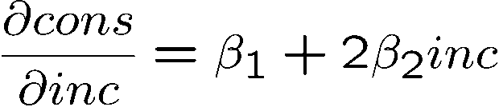
Motivation for multiple regression
Example: Family income and family consumption
Model has two explanatory variables: inome and income squared
Consumption is explained as a quadratic function of income
One has to be very careful when interpreting the coefficients:
Other factors
Family consumption
Family income
Family income squared
By how much does consumption
increase if income is increased
by one unit?
Depends on how much income is already there

Slide 7
Motivation for multiple regression
Example: CEO salary, sales and CEO tenure
Model assumes a constant elasticity relationship between CEO salary and the sales of his or her firm
Model assumes a quadratic relationship between CEO salary and his or her tenure with the firm
Meaning of linear regression
The model has to be linear in the parameters (not in the variables)
Log of CEO salary
Log sales
Quadratic function of CEO tenure with firm

Slide 8
2. The Three-Variable Model: Notation and Assumptions
Assumptions
1. Linear regression model, or linear in the parameters.
2. Zero mean value of disturbance u_{i}: E(u_{i}|X_{2i}, X_{3i}) = 0
3. No serial correlation between the disturbances:
Cov(u_{i},u_{j}) = 0, i ≠ j
4. Homoscedasticity or constant variance of u_{i}: Var(u_{i})=σ²
5. Zero covariance between u_{i} and each X variable
cov (u_{i}, X_{2i}) = cov (u_{i},X_{3i}) = 0
6. No specification bias or the model is correctly specified.
7. No exact collinearity between the X variables.

Slide 9
3. OLS Estimation for the three-variable model
To find the OLS estimators, let us first write the sample regression function (SRF) as follows:
The residual sum of squares (RSS) ∑uˆ²_{i} is as small as possible

Slide 10
Example- Stata output
Model: wage = f(educ,exper )

Slide 11
4. Properties of OLS estimators
The sample regression line (surface) passes through the means of
The mean value of the estimated Yi is equal to the mean value of f the actual Yi.
Sum of residuals is equal to 0
The residuals are uncorrelated with X_{ki} :
The residuals are uncorrelated with

Slide 12
4. Properties of OLS estimators
Gauss-Markov Theorem are the best linear unbiased estimators (BLUEs) of
An estimator is an unbiased estimator of if
An estimator of is linear if and only if it can be expressed as a linear function of the data on the dependent variable:
“best” is defined as smallest variance.

Slide 13
4. Properties of OLS estimators
Standard errors of the OLS estimators
An unbiased estimator of :
→ This is not a true estimator because we can not observe the ui.
The unbiased estimator of :
follows distribution with df = number of observations – number of estimated parameters = n-k
Positive is called the standard error of the regression (SER) (or Root MSE). SER is an estimator of the standard deviation of the error term.

Slide 14
4. Properties of OLS estimators
Where is total sample variation in xj and is the R-squared from regressing xj on all other independent variables (and including an intercept).
Since is unknown, we replace it with its estimator . Standard error:

Slide 15
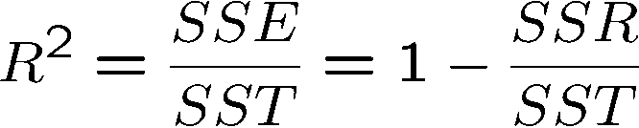
5. A measure of “Goodness of fit”
Decomposition of total variation
Goodness-of-fit measure (R-squared)
Total variation
Explained part
Unexplained part
R-squared measures the fraction of the total variation that is explained by the regression. → 0 ≤ r² ≤ 1

Slide 16
Example- Goodness of fit
Determinants of college GPA:
-

Slide 17
5. Goodness-of-fit or coefficient of determination R²
Note that R² lies between 0 and 1.
If it is 1, the fitted regression line explains 100 percent of the variation in Y
If it is 0, the model does not explain any of the variation in Y.
The fit of the model is said to be “better’’ the closer R² is to 1
As the number of independent variables increases, R² almost invariably increases and never decreases.

Slide 18
R² and the adjusted R²
An alternative coefficient of determination:
where k = the number of parameters in the model including the intercept term.

Slide 19
R² and the adjusted R²
It is good practice to use adjusted R2 than R2 because R2 tends to give an overly optimistic picture of the fit of the regression, particularly when the number of explanatory variables is not very small compared with the number of observations.

Slide 20
The game of maximizing adjusted R2
Researchers play the game of maximizing adjusted R2, that is, choosing the model that gives the highest adjusted R2. → This may be dangerous.
Our objective is not to obtain a high adjusted R2 per se but rather to obtain dependable estimates if the true population regression coefficients and draw statistical inferences about them.
Researchers should be more concerned about the logical or theoretical relevance of the explanatory variables to the dependent variable and their statistical significance.
Even if R-squared is small (as in the given example), regression may still provide good estimates of ceteris paribus effects

Slide 21
Comparing Coefficients of Determination R²
It is crucial to note that in comparing two models on the basis of the coefficient of determination, whether adjusted or not
the sample size n must be the same
the dependent variable must be the same
the explanatory variables may take any form.
Thus for the models
lnY_{i} = β₁ + β₂X_{2i} + β₃X_{3i} + u_{i} (1)
Y_{i} = α₁ + α₂X_{2i} + α₃X_{3i} + u_{i} (2)
the computed R² terms cannot be compared

Slide 22
6. More on Functional Form The Cobb–Douglas Production Function
The Cobb–Douglas production function, in its stochastic form, may be expressed as:
(1)
where Y = output
X₂ = labor input
X₃ = capital input
u = stochastic disturbance term
e = base of natural logarithm
if we log-transform this model, we obtain:
ln Yi = ln β₁ + β₂ lnX_{2i} + β₃lnX_{3i} + u_{i}
= β₀ + β₂lnX_{2i} + β₃lnX_{3i} + u_{i} (2)
where β₀ = ln β₁.

Slide 23
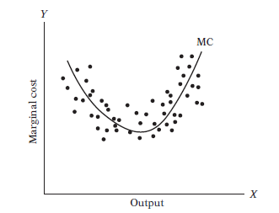
6. More on Functional Form Polynomial Regression Models
The U-shaped marginal cost curve shows that the relationship between MC and output is nonlinear. the parabola is represented by the following equation:
Y = β₀ + β₁X + β₂X_{i}² (4)
which is called a quadratic function,

Slide 24
6. More on Functional Form Polynomial Regression Models
The general k^{th} degree polynomial regression may be written as
Y_{i} = β₀ + β₁X_{i} + β₂X_{i}²+ · · ·+β_{k}X_{i}^{k} + u_{i} (5)

Slide 25
7. Hypothesis Testing in Multiple Regression
7.1. Testing hypotheses about an individual partial regression coefficient
7.2. Testing the overall significance of the estimated multiple regression model, that is, finding out if all the partial slope coefficients are simultaneously equal to zero.
7.3. Testing that two or more coefficients are equal to one another
7.4. Testing that the partial regression coefficients satisfy certain restrictions
7.5 Testing for Structural or Parameter Stability of Regression Models: The Chow Test

Slide 26
7.1. Hypothesis testing about individual coefficients
A hypothesis about any individual partial regression coefficient.
H₀: β_{j} = 0
H₁: β_{j} # 0
Xj has no effect on the expected value of Y
→ The null hypothesis in most applications.
Compare |t| with critical values:

Slide 27
Testing Hypotheses on the coefficients
Hypotheses | H₀ | Alternative hypothesis H₁ | Rejection region
Two tail |  |  | |t₀|>t_{(n-k),α/2}
Right tail |  |  | t₀ > t_{(n-k),α}
Left tail |  |  | t₀ <- t_{(n-k),α}

Slide 28
Example 2: Determinants of college GPA
-

Slide 29
A reminder on the language of classical hypothesis testing
When H0 is not rejected → “We fail to reject H0 at the x% level”, do not say: “H0 is accepted at the x% level”.
Statistical significance vs economic significance: The statistical significance is determined by the size of the t-statistics whereas the economic significance is related to the size and sign of the estimators.

Slide 30
Guidelines for discussing economic and statistical significance
If a variable is statistically significant, discuss the magnitude of the coefficient to get an idea of its economic or practical importance
The fact that a coefficient is statistically significant does not necessarily mean it is economically or practically significant!
If a variable is statistically and economically important but has the wrong sign, the regression model might be misspecified.

Slide 31
7.2. Testing the Overall Significance of the Sample Regression
For Y_{i} = β₁ + β₂X_{2i} + β₃X_{3i} + ........+ β_{k}X_{ki} + u_{i}
To test the hypothesis
H₀: β₂ =β₃ =....= β_{k}= 0 (all slope coefficients are simultaneously zero)
(this is also a test of significance of R2)
H₁: Not at all slope coefficients are simultaneously zero
(k = total number of parameters to be estimated including intercept)
If F > F _{critical} = F_{α,(k-1,n-k)}, reject H_{0,} Otherwise you do not reject it

Slide 32


7.3. Testing the Equality of Two Regression Coefficients
Suppose in the multiple regression
Y_{i} = β₁ + β₂X_{2i} + β₃X_{3i} + β₄X_{4i} + u_{i}
we want to test the hypotheses
H₀: β₃ = β₄ or (β₃ − β₄) = 0
H₁: β₃ ≠ β₄ or (β₃ − β₄) ≠ 0
that is, the two slope coefficients β3 and β4 are equal.
If the t statistic exceeds the critical value, then you can reject the null hypothesis; otherwise, you do not reject it

Slide 33
Example- Stata output
Model: wage = f(educ,exper, tenure )

Slide 34
Example- Stata output
Model: wage = f(educ,exper, tenure )

Slide 35
Example- Stata output
We have
t = -4.958
Reject H0

Slide 36
7.3. Testing the Equality of Two Regression Coefficients
Method 2: F-test
If the F statistics exceeds the critical value then you can reject the null hypothesis; otherwise, you do not reject it.

Slide 37


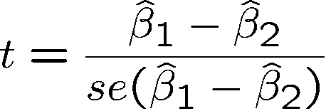
7.3. Testing the Equality of Two Regression Coefficients
Method 3
Example: Return to education at 2 year vs. at 4 year colleges
Years of education at 2 year colleges
Years of education at 4 year colleges
Test against .
A possible test statistic would be:

Slide 38
twoyear.dta

Slide 39



7.3. Testing the Equality of Two Regression Coefficients
Method 3
Usually not available in regression output
Define and test against .
Insert into original regression
a new regressor (= total years of college)

Slide 40
7.3. Testing the Equality of Two Regression Coefficients
Stata output F-test
. test exper=tenure
( 1) exper - tenure = 0
F( 1, 522) = 24.58
Prob > F = 0.0000
→ We reject the hypothesis that the two effects are equal.

Slide 42
7.4. Restricted Least Squares: Testing Linear Equality Restrictions
Now consider the Cobb–Douglas production function:
(1)
where Y = output
X₂ = labor input
X₃ = capital input
Written in log form, the equation becomes
ln Yi = ln β₁ + β₂ lnX_{2i} + β₃lnX_{3i} + u_{i}
= β₀ + β₂lnX_{2i} + β₃lnX_{3i} + u_{i} (2)
where β₀ = ln β₁.

Slide 43
7.4. Restricted Least Squares: Testing Linear Equality Restrictions
If there are constant returns to scale, economic theory would suggest that:
β₂ + β₃ = 1
which is an example of a linear equality restriction.
If the restriction is valid? There are two approaches:
The t-Test Approach
The F-Test Approach

Slide 44
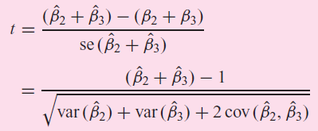
The t-Test Approach
If the t statistic exceeds the critical value, we reject the hypothesis of constant returns to scale. Otherwise we do not reject it.

Slide 45
The F-Test Approach
If the restriction is true: β₂ = 1 − β₃
we can write the Cobb–Douglas production function as
lnY_{i} = β₀ + (1 − β₃) ln X_{2i} + β₃ ln X_{3i} + u_{i}
= β₀ + ln X_{2i} + β₃(ln X_{3i} − ln X_{2i} ) + u_{i}
or (lnY_{i} − lnX_{2i}) = β₀ + β₃(lnX_{3i} − lnX_{2i} ) + u_{i}
or ln(Y_{i}/X_{2i}) = β₀ + β₃ln(X_{3i}/X_{2i}) + u_{i} (3)
Where (Y_{i}/X_{2i}) = output/labor ratio
(X_{3i}/X_{2i}) = capital/labor ratio
Eq. (1): unrestricted model
Eq. (3): restricted model.

Slide 46


The F-Test Approach
We want to test the hypotheses
H₀: β₂ + β₃ = 1 (the restriction H₀ is valid)
RSS_{UR}: RSS of the unrestricted regression
RSS_{R} : RSS of the restricted regression
m = number of linear restrictions (1 in the present example)
k = number of parameters in the unrestricted regression
n = number of observations
If the F statistic > the critical F value at the chosen level of significance, we reject the hypothesis H₀

Slide 47
A Cautionary Note
Keep in mind that if the dependent variable in the restricted and unrestricted models is not the same, R2(unrestricted) and R2(restricted) are not directly comparable.

Slide 48

Testing multiple linear restrictions: The F-test
Testing exclusion restrictions (\MLB1.DTA)
Salary of major lea-
gue base ball player
Years in
the league
Average number of
games per year
Batting average
Home runs per year
Runs batted in per year
against
Test whether performance measures have no effect/can be exluded from regression.

Slide 49
Testing multiple linear restrictions: The F-test
Estimation of the unrestricted model
None of these variabels is statistically significant when tested individually
Idea: How would the model fit be if these variables were dropped from the regression?

Slide 50
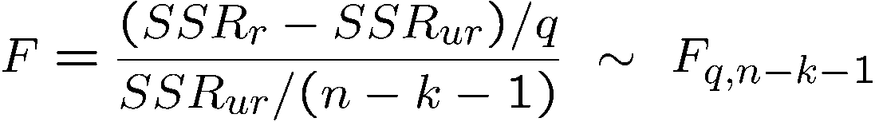
Testing multiple linear restrictions: The F-test
Estimation of the restricted model
Test statistic
The sum of squared residuals necessarily increases, but is the increase statistically significant?
Number of restrictions

Slide 51
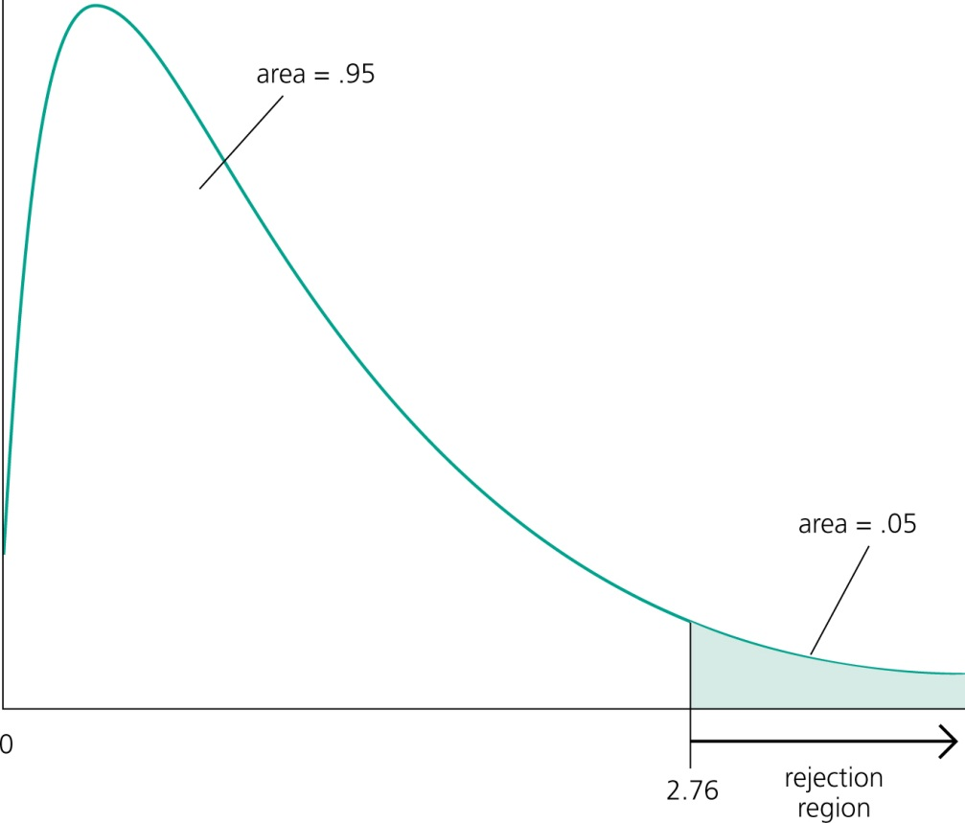
F-distribution
Rejection rule
A F-distributed variable only takes on positive values. This corresponds to the fact that the sum of squared residuals can only increase if one moves from H₁ to H₀.
Choose the critical value so that the null hypo-thesis is rejected in, for example, 5% of the cases, although it is true.

Slide 52
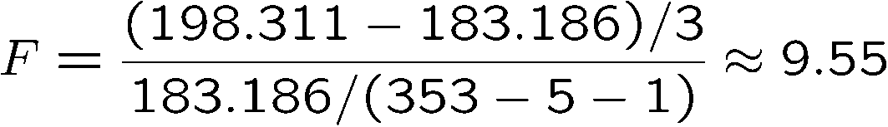
Testing multiple linear restrictions: The F-test
Test decision in example
Discussion
The three variables are „jointly significant“
They were not significant when tested individually
The likely reason is multicollinearity between them
Number of restrictions to be tested
Degrees of freedom in
the unrestricted model
The null hypothesis is overwhel-mingly rejected (even at very small significance levels).

Slide 53
Test hypothesis that, after controlling for cigs, parity, and faminc, parents’ education has no effect on birth weight

Slide 54
7.5. Testing for Structural or Parameter Stability of Regression Models: The Chow Test
Now we have three possible regressions:
Time period 1970–1981: Y_{t} = λ₁ + λ₂X_{t} + u_{1t} (1)
Time period 1982–1995: Y_{t} = γ₁ + γ₂X_{t} + u_{2t} (2)
Time period 1970–1995: Y_{t} = α₁ + α₂X_{t} + u_{t} (3)
there is no difference between the two time periods. The mechanics of the Chow test are as follows:
1. Estimate regression (3), obtain RSS3 with df = (n1 + n2 − k)
We call RSS3 the restricted residual sum of squares (RSS_{R}) because it is obtained by imposing the restrictions that λ1 = γ1 and λ2 = γ2, that is, the subperiod regressions are not different.
2. Estimate Eq. (1) and obtain its residual sum of squares, RSS1, with df = (n1 − k).
3. Estimate Eq. (2) and obtain its residual sum of squares, RSS2, with df = (n2 − k).

Slide 55

7.5. Testing for Structural or Parameter Stability of Regression Models: The Chow Test
4. The unrestricted residual sum of squares (RSS_{UR}), that is,
RSS_{UR} = RSS1 + RSS2 with df = (n1 + n2 − 2k)
5. F ratio:
6. If the computed F value exceeds the critical F value, we reject the hypothesis of parameter stability conclude that the regressions (1) and (2) are different

Slide 56
END OF CHAPTER 3

